Slide 1
Integration Patterns and Frameworks
SE495: Software and Systems Integration

Slide 2
Outline
Overview of integration patterns
Enterprise integration patterns (EIP)
Data integration patterns
Application integration patterns
Integration framework selection
Case Study

Slide 3
Overview of integration patterns

Slide 4
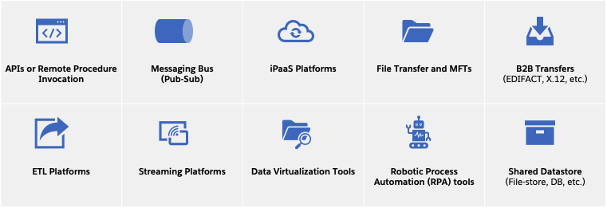
What are integration patterns?
Integration patterns are reusable solutions to common integration problems.
They provide templates to solve recurring technical challenges in an integration architecture.
Examples: messaging patterns like publish-subscribe, data mapping, etc.

Slide 5
Benefits of using integration patterns
Improved flexibility and adaptability: Patterns provide loose coupling between systems
Increased reusability: Patterns can be applied again and again in different use cases
Higher robustness: Patterns incorporate solutions to common error handling and edge cases
Faster development: Patterns provide pre-built templates to accelerate implementing integrations
Improved documentation: Patterns provide a shared vocabulary to discuss integration solutions

Slide 6
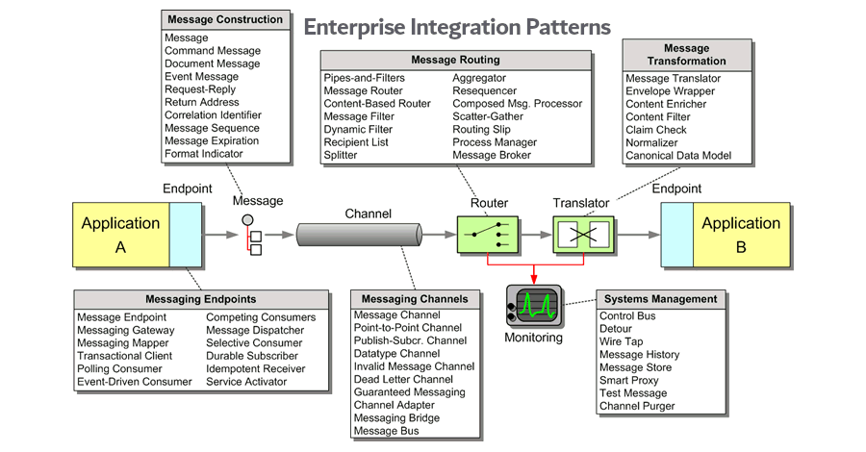
Common types of integration patterns
Messaging patterns: publish-subscribe, point-to-point messaging, etc.
Routing patterns: content-based router, message filter, etc.
Data patterns: data mapper, canonical data model, etc.
Transaction patterns: transaction coordinator, compensating transaction, etc.
Management and monitoring patterns: wire tap, message store, etc.

Slide 7
When to use integration patterns?
Use patterns when implementing a new integration architecture
Apply patterns when redesigning or improving an existing integration architecture
Consider patterns when facing recurring integration challenges (data mapping, asynchronous messaging, etc.)
Look for patterns if aiming to build a scalable, robust and flexible integration solution

Slide 8
Enterprise integration patterns (EIP)

Slide 9
What are Enterprise Integration Patterns?
EIPs are a collection of 65 patterns that cover messaging, routing, transformation, and more.
They provide a standardized vocabulary and recommended solutions for enterprise application integration.
They were compiled by Gregor Hohpe and Bobby Woolf in their book “Enterprise Integration Patterns”.

Slide 10
Examples of EIPs
Messaging Patterns: Publish-Subscribe, Point-to-Point Channel, Message Bus, etc.
Routing Patterns: Content-Based Router, Message Filter, Dynamic Router, etc.
Transformation Patterns: Envelope Wrapper, Content Enricher, Canonical Data Model, etc.
Transaction Patterns: Transactional Client, Transactional Server, etc.

Slide 11
Benefits of using EIPs
Improved flexibility and loose coupling between applications
Increased reusability of integration logic
Higher resilience and error handling
Faster development by using pre-built templates
Shared vocabulary to discuss integration challenges and their solutions

Slide 12
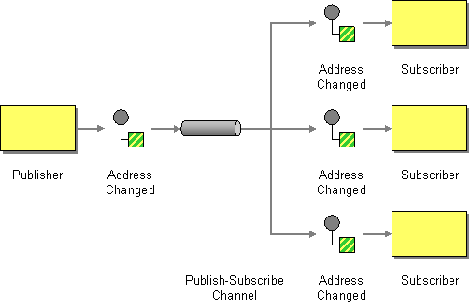
Publish-Subscribe Channel
Used to broadcast messages to multiple interested subscribers.
Publishers send messages to a channel which then distributes them to subscribers.

Slide 13
Publish-Subscribe Channel
How can the sender broadcast an event to all interested receivers?
Send the event on a Publish-Subscribe Channel, which delivers a copy of a particular event to each receiver.
A Publish-Subscribe Channel works like this: It has one input channel that splits into multiple output channels, one for each subscriber.
When an event is published into the channel, the Publish-Subscribe Channel delivers a copy of the message to each of the output channels. Each output channel has only one subscriber, which is only allowed to consume a message once.
In this way, each subscriber only gets the message once and consumed copies disappear from their channels.

Slide 14
Message Translator
Used to convert message formats and translate between different message versions or standards.
Required when applications use different message formats.

Slide 15
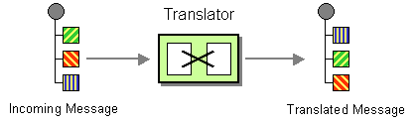
Message Translator
How can systems using different data formats communicate with each other using messaging?
Use a special filter, a Message Translator, between other filters or applications to translate one data format into another.
The Message Translator is the messaging equivalent of the Adapter pattern described in [GoF]. An adapter converts the interface of a component into a another interface so it can be used in a different context.

Slide 16
Aggregator
Used to combine multiple messages into a single message.
The Aggregator pattern correlates and combines messages that are part of the same logical "conversation" before passing them on.
Often used to combine responses to a request that comes back in separate messages.

Slide 17
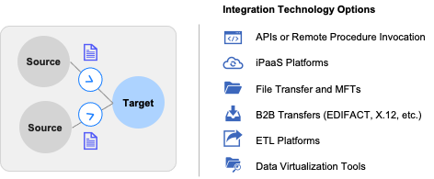
Aggregator
Businesses consolidate data from multiple sources for semantic completeness and contextualization purposes.
Building a single view of customer
Migrating data from on-prem applications to a cloud-based data warehouse
Consolidating sensor data and ERP data for advanced analytics on usage patterns
Preparation of executive sales dashboards

Slide 18
Data integration patterns

Slide 19
What are Data Integration Patterns?
Data integration patterns deal with challenges related to integrating data across applications and systems.
They provide templates to perform data migration, transformation, synchronization, etc.
Examples: Canonical data model, Data mapping, Data replication, Data consolidation, etc.

Slide 20
Benefits of Data Integration Patterns
Consistent view of data across applications
Ability to migrate data from one system to another
Support for data synchronization and replication
Handling of data transformations and semantic mismatches between systems
Improved data quality and consistency

Slide 21
Common Data Integration Patterns
Canonical Data Model: A standardized data format used to exchange data between systems
Data Mapping: Transforming data from one format to another
Data Migration: Moving data from one system to another
Data Replication: Copying data between systems to keep information synchronized
Data Consolidation: Combining data from multiple sources into a single data store

Slide 22
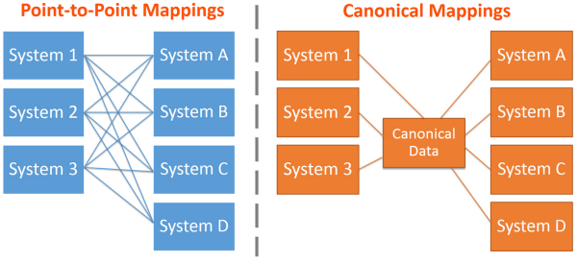
Canonical Data Model
A standardized model to enable data exchange between systems.
Maps from system-specific formats to a common format.
A canonical data model (CDM) is a type of data model that presents data entities and relationships in the simplest possible form.

Slide 23
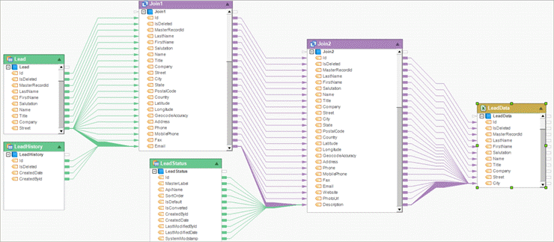
Data Mapping
Specification of how data is transformed from one format to another.
Used when two systems use different semantics or data formats. Performed by data mapping tools.
This reduces the potential for errors, helps standardize your data and makes it easier to understand your data.

Slide 24
Data Mapping
Data mapping is a critical component of data integration and is used in many different types of systems, such as data warehousing, ETL processes, and application integration.
Effective data mapping requires a thorough understanding of both the source and target data models.
Best practices for data mapping include using automated tools, validating the mapping, and maintaining the mapping over time.

Slide 25
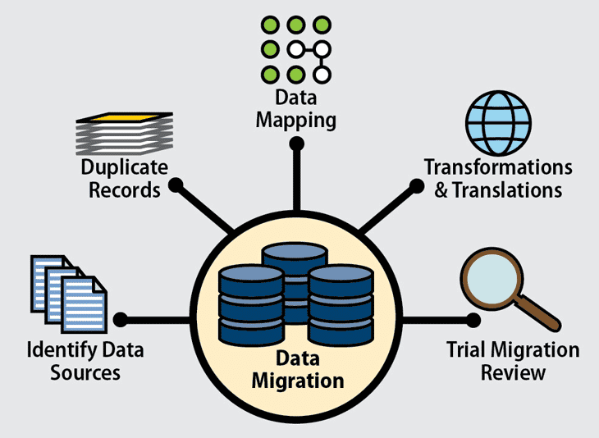
Data Migration
Data migration is the process of transferring data from one system or storage location to another.
The goal of data migration is to move data from an old or outdated system to a new system that offers improved performance, features, or functionality.
Data migration can involve moving data from one database to another, from one application to another, or from one physical storage medium to another.

Slide 26
Data Migration
Data migration can be a complex and time-consuming process, requiring careful planning and execution to ensure that data is transferred accurately and securely.
The process of data migration typically involves several different steps, including:
planning,
data profiling,
data cleansing,
mapping,
testing, and
deployment.

Slide 27
Data Migration
One of the biggest challenges in data migration is ensuring data quality and integrity throughout the process.
This requires careful attention to data profiling and cleansing, as well as thorough testing and validation.
There are several different approaches to data migration, including manual migration, automated migration, and a combination of both.

Slide 28
Data Migration
Effective data migration requires a clear understanding of the source and target systems, as well as a detailed understanding of the data itself.
This requires collaboration between technical teams, business stakeholders, and data owners.
Data migration can offer significant benefits, including improved system performance, increased functionality, and reduced costs.
However, data migration also carries some risks, including data loss, data corruption, and system downtime.
It is important to carefully plan and execute data migration projects to minimize these risks and ensure a successful outcome.

Slide 29
Data Replication
Continuous synchronization of data between source and target systems.
Ensures that data is consistent across systems.
Can be uni-directional (one-way) or bi-directional (two-way).
Requires monitoring replications to handle errors and resolve data conflicts.
Data replication is the process of making multiple copies of data and storing them at different locations for backup purposes, fault tolerance and to improve their overall accessibility across a network.

Slide 30
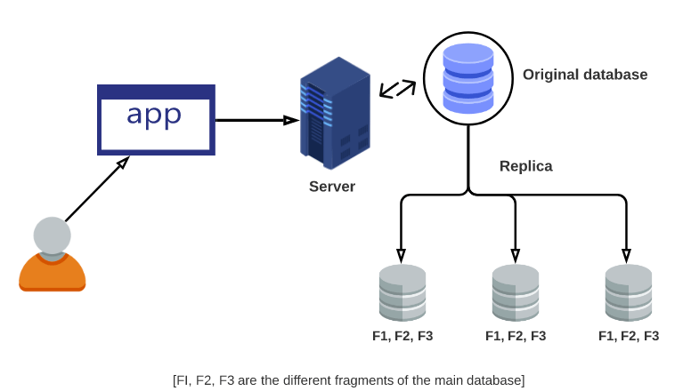
Data Replication
Similar to data mirroring, data replication can be applied to both individual computers and servers.
The data replicates can be stored within the same system, on-site and off-site hosts, and cloud-based hosts.
Data replication is commonly used in distributed systems, such as multi-tiered applications, data warehouses, and cloud computing environments.

Slide 31
Data Consolidation
Data consolidation is the process of combining data from multiple sources into a single, unified view.
The goal of data consolidation is to provide a comprehensive and accurate view of data that can be used for reporting, analysis, and decision-making.
Data consolidation is commonly used in situations where data is stored across multiple systems or applications, such as in mergers and acquisitions, or in organizations with multiple departments or business units.

Slide 32
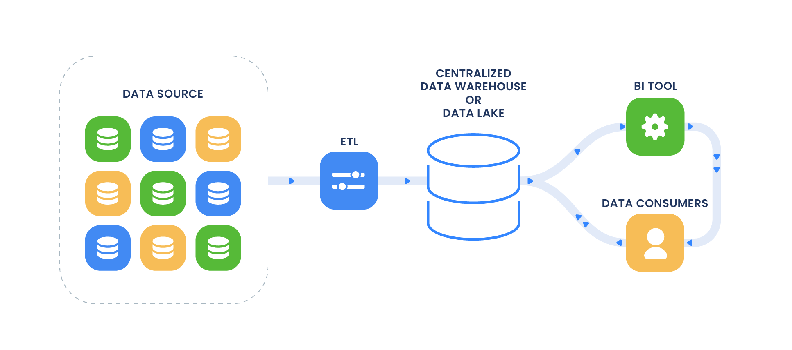
Data Consolidation
Data consolidation can be implemented using a variety of technologies, including data warehouses, data lakes, and master data management (MDM) systems.
Each approach has its own advantages and limitations, and the choice of technology will depend on the specific requirements of the application.

Slide 33
Application integration patterns

Slide 34
Application integration patterns
Application integration patterns refer to a set of tried and tested design approaches for integrating applications and systems within an organization to enable them to work together seamlessly.
These patterns provide a framework for creating flexible, scalable, and maintainable integrations between different applications and systems, regardless of their technologies, platforms, or protocols.

Slide 35
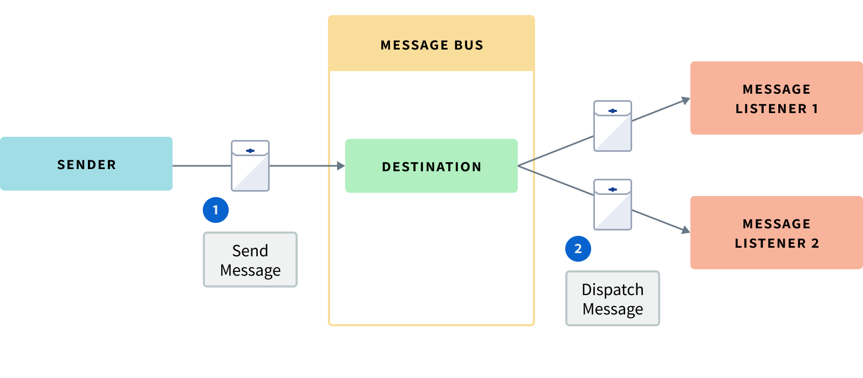
Application integration patterns
Message Bus
This pattern involves using a message broker to enable applications to communicate with each other via a shared message bus.
This allows for asynchronous messaging, which can improve system performance and reliability.

Slide 36
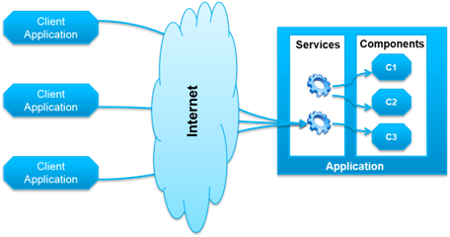
Application integration patterns
Service-Oriented Architecture (SOA)
This pattern involves breaking down applications into smaller, reusable services that can be accessed by other applications through standardized interfaces.
This enables greater flexibility and agility in application development and integration.

Slide 37
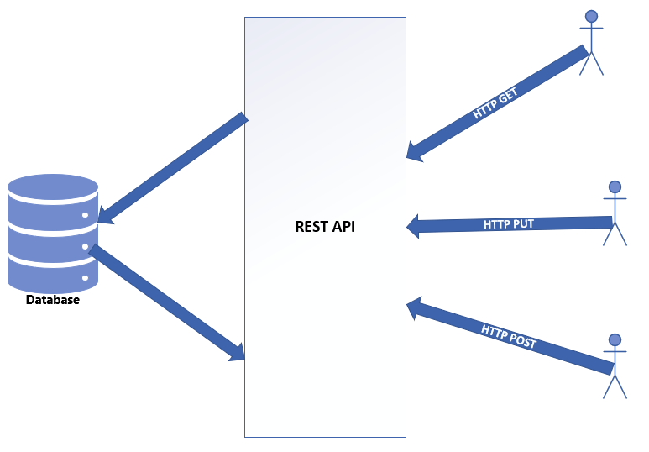
Application integration patterns
Representational State Transfer (REST)
This pattern involves using a set of standard HTTP methods (GET, POST, PUT, DELETE) to exchange data between applications.
This enables a uniform, lightweight, and scalable approach to integration.

Slide 38
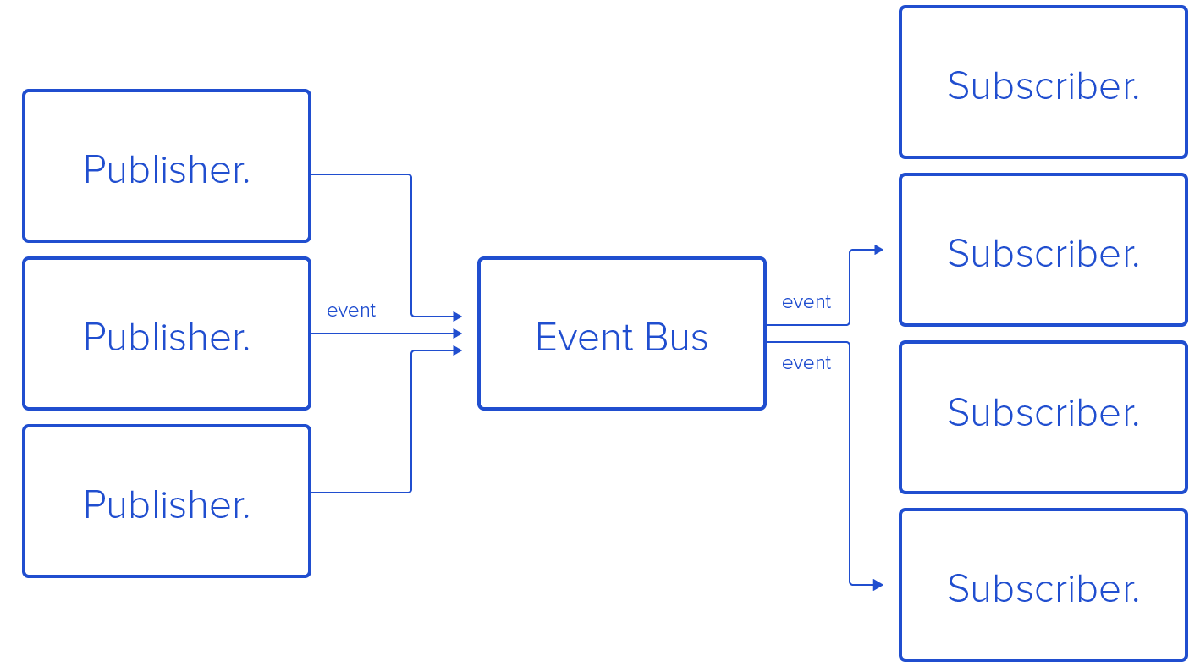
Application integration patterns
Publish-Subscribe
This pattern involves using a topic-based messaging system to enable applications to subscribe to relevant messages and receive updates in real-time.
This is useful for applications that require up-to-date information, such as stock market data or social media updates.

Slide 39
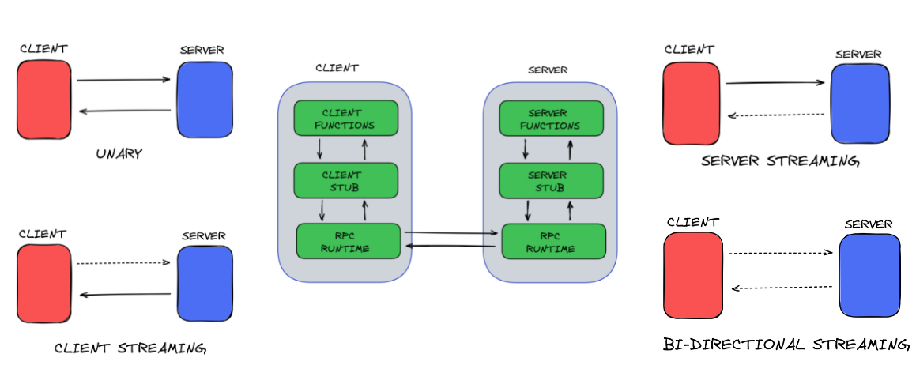
Application integration patterns
Remote Procedure Call (RPC)
This pattern involves invoking a procedure or method on a remote application or system, as if it were a local function call.
This enables applications to interact with each other as if they were running on the same machine, which can simplify integration and reduce complexity.

Slide 40
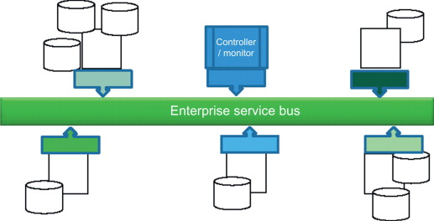
Application integration patterns
Enterprise Service Bus (ESB)
This pattern involves using an intermediary service bus to manage the flow of data and messages between applications.
The ESB provides a centralized hub for routing, transformation, and mediation, which can simplify integration and improve scalability.

Slide 41
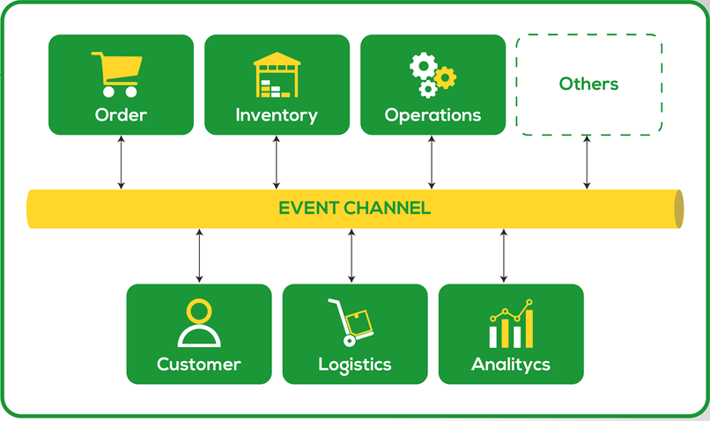
Application integration patterns
Event-driven architecture (EDA)
EDA is a design approach that focuses on the flow of events between applications.
Events are notifications that something has happened, such as a customer placing an order or a product being shipped.

Slide 42
Integration framework selection

Slide 43
Considerations
Selecting the right integration framework is a critical decision that can have a significant impact on the success of a project.
To choose the right framework, there are several key considerations that should be taken into account:
Programming language
The choice of programming language will depend on the specific needs of the project and the skills and preferences of the development team.
Some integration frameworks are language-agnostic, while others are specific to a particular language or platform.
Protocol support
The framework should support the protocols and data formats that are used by the systems that need to be integrated.
This may include support for RESTful APIs, SOAP, XML, JSON, and other common integration protocols.

Slide 44
Considerations
Orchestration capability
The framework should provide a way to orchestrate the integration process, including routing messages, transforming data, and coordinating workflows.
This may involve the use of a workflow engine, business process management (BPM) tools, or other orchestration capabilities.
Community support
The framework should have an active and supportive community of developers and users.
This can provide access to resources, tutorials, and best practices, as well as a forum for troubleshooting and problem-solving.
Licensing cost
The framework should be affordable and cost-effective, taking into account factors such as licensing fees, maintenance costs, and deployment expenses.
Open source frameworks may be a good option for organizations with limited budgets, while commercial frameworks may offer additional features and support.

Slide 45
Considerations
Scalability
The framework should be scalable and able to handle the expected volume of data and traffic.
This includes support for clustering, load balancing, and other techniques for managing system capacity and performance.
Security
The framework should provide robust security features to protect data and prevent unauthorized access.
This includes support for encryption, authentication, and authorization, as well as compliance with relevant security standards and regulations.
Ease of use
The framework should be easy to use and integrate with existing systems and applications.
This may involve providing a user-friendly interface, clear documentation, and support for common development tools and workflows.

Slide 46
Considerations
Vendor support
The framework should have strong vendor support, including regular updates, bug fixes, and technical support.
This can help to ensure that the framework remains up-to-date and compatible with other systems and applications.
Integration with other systems
The framework should be compatible with other systems and applications, including legacy systems, cloud-based platforms, and third-party APIs.
This can help to ensure that the integration process is seamless and effective, and that data can be exchanged between systems without complications.

Slide 47
Point-to-point
Frameworks that enable building point-to-point integrations. Mention frameworks like Apache Camel, MuleSoft, etc. Discuss pros/cons.

Slide 48
Hub-and-spoke
Frameworks that implement hub-and-spoke architecture. Mention frameworks like Apache NiFi, Azure Data Factory, etc. Discuss pros/cons.

Slide 49
Message brokers
Discuss using message brokers like RabbitMQ, Apache Kafka, Azure Service Bus, etc. Mention pros/cons of message broker based integration.

Slide 50
iPaaS offerings
Discuss iPaaS platforms like Dell Boomi, Informatica Cloud, MuleSoft CloudHub, etc. that provide pre-built connectors and integrations. Mention pros/cons of iPaaS solutions.

Slide 51
On-prem vs Cloud
Compare on-premises vs cloud-based integration frameworks. Discuss pros/cons of each option. Mention some examples of each type.

Slide 52
Recommendations
Provide recommendations for selecting an integration framework based on use case, functionality, cost, etc. Mention that there is no “one size fits all” solution. Several options may need to be evaluated based on specific needs.

Slide 53
Case Study

Slide 54
ACME Retail
A large retail company, ACME Retail, has a complex IT landscape with many disparate systems.
They have:
An ERP system for managing their backend business processes like finance, HR, supply chain, etc.
A CRM system for managing customer relationships and sales.
A legacy inventory management system.
Multiple ecommerce portals for online sales.
Many standalone reporting and analytics tools.

Slide 55
ACME Retail
ACME wants to integrate these systems to have a single view of their business and customers.
They decide to implement an integration framework to orchestrate the integration between these systems.
For backend process integration between the ERP and legacy systems, they use the enterprise integration pattern (EIP) of message router.
The ERP and inventory management systems exchange business documents (like purchase orders) asynchronously through a message broker like RabbitMQ.
The message broker then routes the messages to the correct destination system.

Slide 56
ACME Retail
For customer data integration between the CRM and ecommerce systems, they use the data integration pattern of data replication.
A data integration tool like Talend pulls customer data from the CRM, transforms it to the target schema of the ecommerce systems, and loads it into the ecommerce databases.
This keeps customer data in sync across systems.

Slide 57
ACME Retail
For exposing some of the ERP and CRM functionality to the ecommerce portals, they use the application integration pattern of API gateway.
They build a REST API gateway that exposes API endpoints for search, checkout, order management, payment processing, etc.
The API gateway then invokes the backend ERP and CRM systems to execute the requests and return the responses.

Slide 58
ACME Retail
After evaluating options, ACME chooses Dell Boomi as their integration framework.
It supports all the integration patterns they need through pre-built connectors and components like message queues, data replication tools, and an API gateway.
The integration framework helps them manage, monitor, and scale the complex integrations across their enterprise.

